Slide 1
Computational Methods to Vocalize Arabic Texts
H. Safadi*, O. Al Dakkak** & N. Ghneim**
hanisaf@gmail.com, odakkak@hiast.edu.sy, n_ghneim@netcourrier.com
*Faculty of Informatics Engineering
**Higher Institute of Applied Science and Technology

Slide 2
Outline
Introduction
Previous Works
Our Work
Implementation Overview
Results
Future Works
Conclusion
References & More Information

Slide 3
Introduction
There are several types of vowels in Arabic:
  long vowels: /A/, /w/, /y/
  short vowels : /a/ (Fatha), /u/ (Damma), /I/ (Kasra)
  Other symbols:
    /F/ Tanween-Fateh ’an’,
    /N/ Tanween-Damm ‘un’ or ‘on’,
    /K/ Tanween-Kasir, ‘in’ or ‘en’,
    /o/ Sukun where the consonant is not followed by a vowel,
    /~/ Shadda which means a duplication of the consonant
  In fact long vowels are long /a/, /u/, /i/. They differ only in duration with the corresponding short ones.

Slide 4
Introduction
Short vowels & other symbols are part of the word and are written as additional marks above or below letters.
These marks are usually not written because Arabic reader can guess them, based on his knowledge of the language and on the context.
They are only put when very necessary, in cases where the word is so ambiguous without them

Slide 5
Purpose
While this problem may be trivial for an Arabic native speaker, it is not for computers and new learners of language.
Examples of applications that demand vocalization of Arabic texts:
Educational tools for children and learners
Search engines
Text to speech engines
Text mining tools

Slide 6
Previous Works
Despite the abundance of computational Arabic studies, Arabic Vocalization is not enough studied.
  Sakhr has a commercial system for Arabic vocalization. Unfortunately, the system is totally closed.
  Y. Gal HMM trained on vocalized Arabic texts (Holy Quranic), 85% of correct vocalization on the same corpus.
  R. Nelken and S. Shieber use weighted finite-state transducers trained on LDC corpus of M. Maamouri et al. 93% of correct vocalization.

Slide 7
Drawbacks of Previous Works
The previous works provide useful attempts to solve the problem; however:
  They tackle the problem with a top-down approach.
  They build a model and train it with a corpus.
  The problem with this approach is that it is highly dependent on the corpus. For example, Quranic texts used in are not good representative of modern Arabic. And newspaper archives in LDC do not cover all the topics in the language.

Slide 8
Our Proposed System
Our work uses a bottom-up approach, where we do a linguistic analysis of Arabic texts, using the following four steps:
Parsing the text.
Analyzing the text morphologically.
Part of speech (POS) tagging of the text.
Applying linguistic heuristics rules.

Slide 9
Parsing
In this step, the text is split into phrases. Each phrase is also split into words.
The process is simple; it uses regular expressions to parse the text.

Slide 10
Morphological Analysis (MA)
Each word is passed to the MA, which provides all the vocal possibilities that can be added to the non-vocalized word & POS tag of each possibility.
Use of Buckwalter Arabic MA
  considers each word as a combination of prefix, stem, and suffix.
  has a dictionary of prefixes, stems, and suffixes,
  has 2 compatibility tables: prefix-stem & stem-suffixes.

Slide 11
MA algorithm *
All the possible combinations of a word to prefix-stem-suffix are considered (as long as the stem length is not zero).
For each combination, the prefix, stem and suffix are checked whether they are contained in the dictionaries or not.
If so, the compatibility between them is considered; if they are compatible, this combination is considered as a possible analysis to the word.

Slide 12
Part of speech tagging
After MA, we must choose the correct POS.
We built a POS tagger for Arabic, using unsupervised transformational based learning methods on collected texts from Internet covering multiple disciplines . (LDC Arabic Corpus not afforded)
The generated rules are then examined manually. For some words, the POS tagging cannot resolve the ambiguity; therefore we need an additional level of processing.

Slide 13
Heuristic rules of disambiguation
Heuristic rules of disambiguation that choose a certain POS with regards to the word and its context.
  Ex.: "if the word length is less than 3 letters, and one of its part of speech is preposition, then choose it".
Finally, if after all these levels, the ambiguity still remains in the word; a random choice of the POS tagged is made.

Slide 14
Implementation Overview
We implemented the system using JavaTM programming language. & some additional tools and GUI.
The implementation allows the user to use each part alone, or use all of them together.
Syntactic analysis is not implemented, final vowels are not considered.

Slide 15
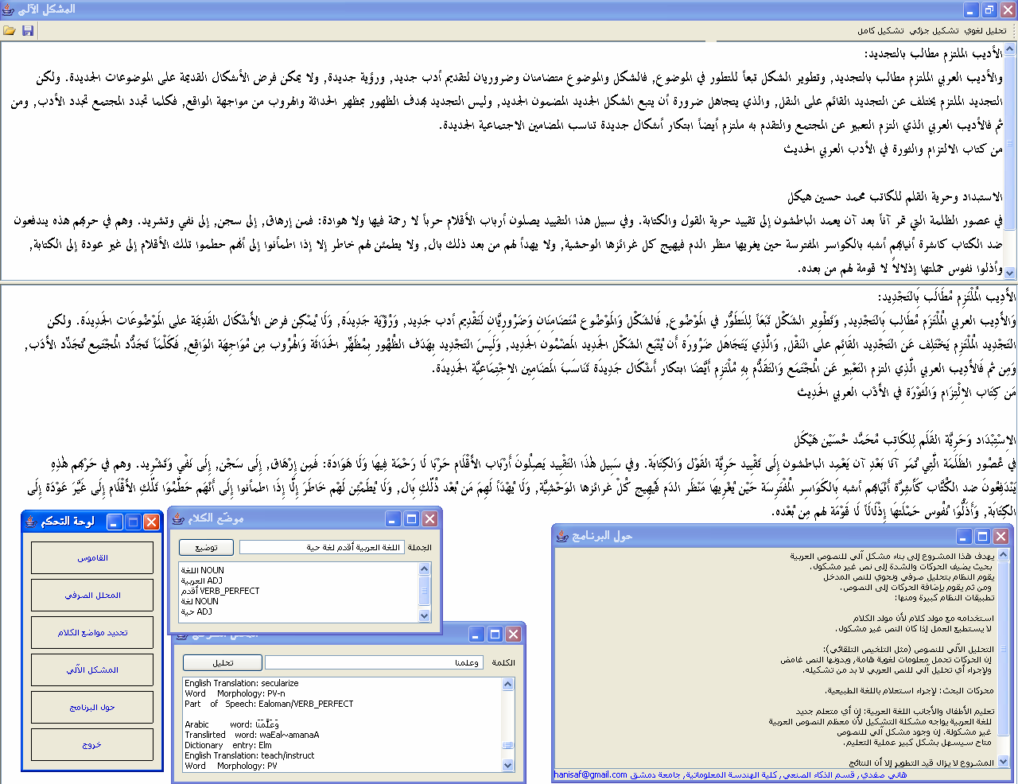
The System’s Different Parts

Slide 16
Results
Because of the lack of digital vocalized Arabic texts, we did not have the opportunity to test our system deeply.
However, we did some empirical tests.
We vocalized large Arabic texts automatically and gave the results to experts in order to evaluate them.
The evaluation shows a percentage of 80-90% of correct vocalization.

Slide 17
Future Works – 1
Syntactic Analysis: Although texts without the last vowels are well understood, adding this additional level will certainly improve the performance.
Semantic Analysis: some semantic analysis can help improving the performance. (Ex. when a word has several possibilities with the same POS).

Slide 18
Future Works – 2
Pragmatic Analysis: This type of analysis is useful in conversations and idiomatic expressions.
Using a supervised method, trained on a tagged corpus, can significantly enhance the part of speech tagging performance.
Our work is not finished and we are still working on improving it.

Slide 19
Conclusion
The problem of restoring vocals in Arabic is essential for computational applications.
Some attempts were made.
We have provided a solution based on linguistic analysis.
An implementation is done, and the results are promising.
We are planning to improve and enhance the system.

Slide 20
Thank you for your attention
Time for questions

